Slide 1
Quantum Hall Effect
Lianghong Mo
20220528

Slide 2
Content
Experimental Phenomena
Landau Levels
Theory of IQHE
Landauer Explanation
Laughlin Gauge Argument
Kubo Fomula and TKNN
Theory of FQHE
Laughlin Wave Function
Composite Fermion
Quantum Phase Transition

Slide 3
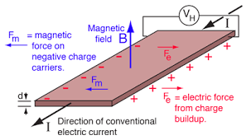
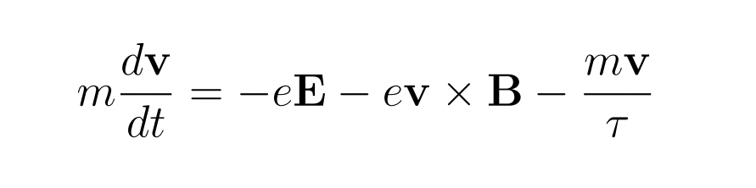


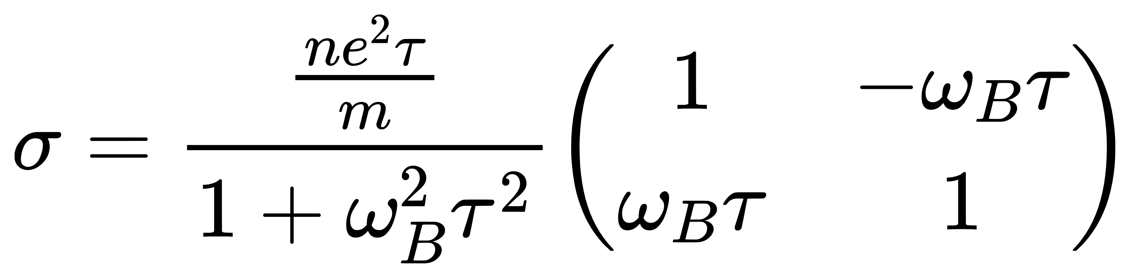
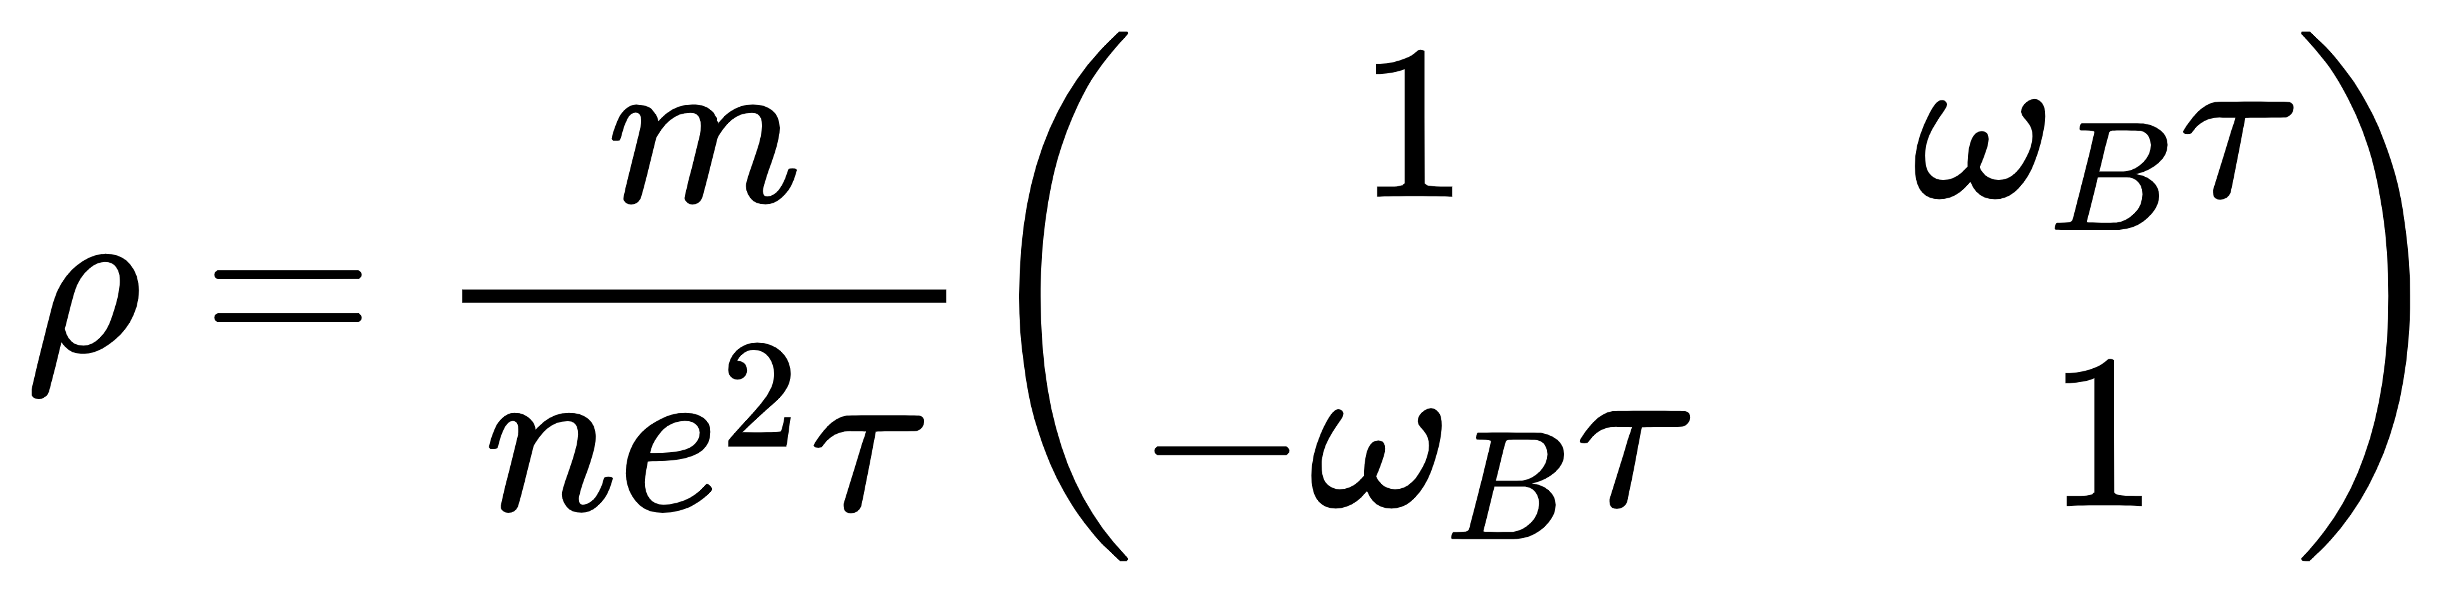
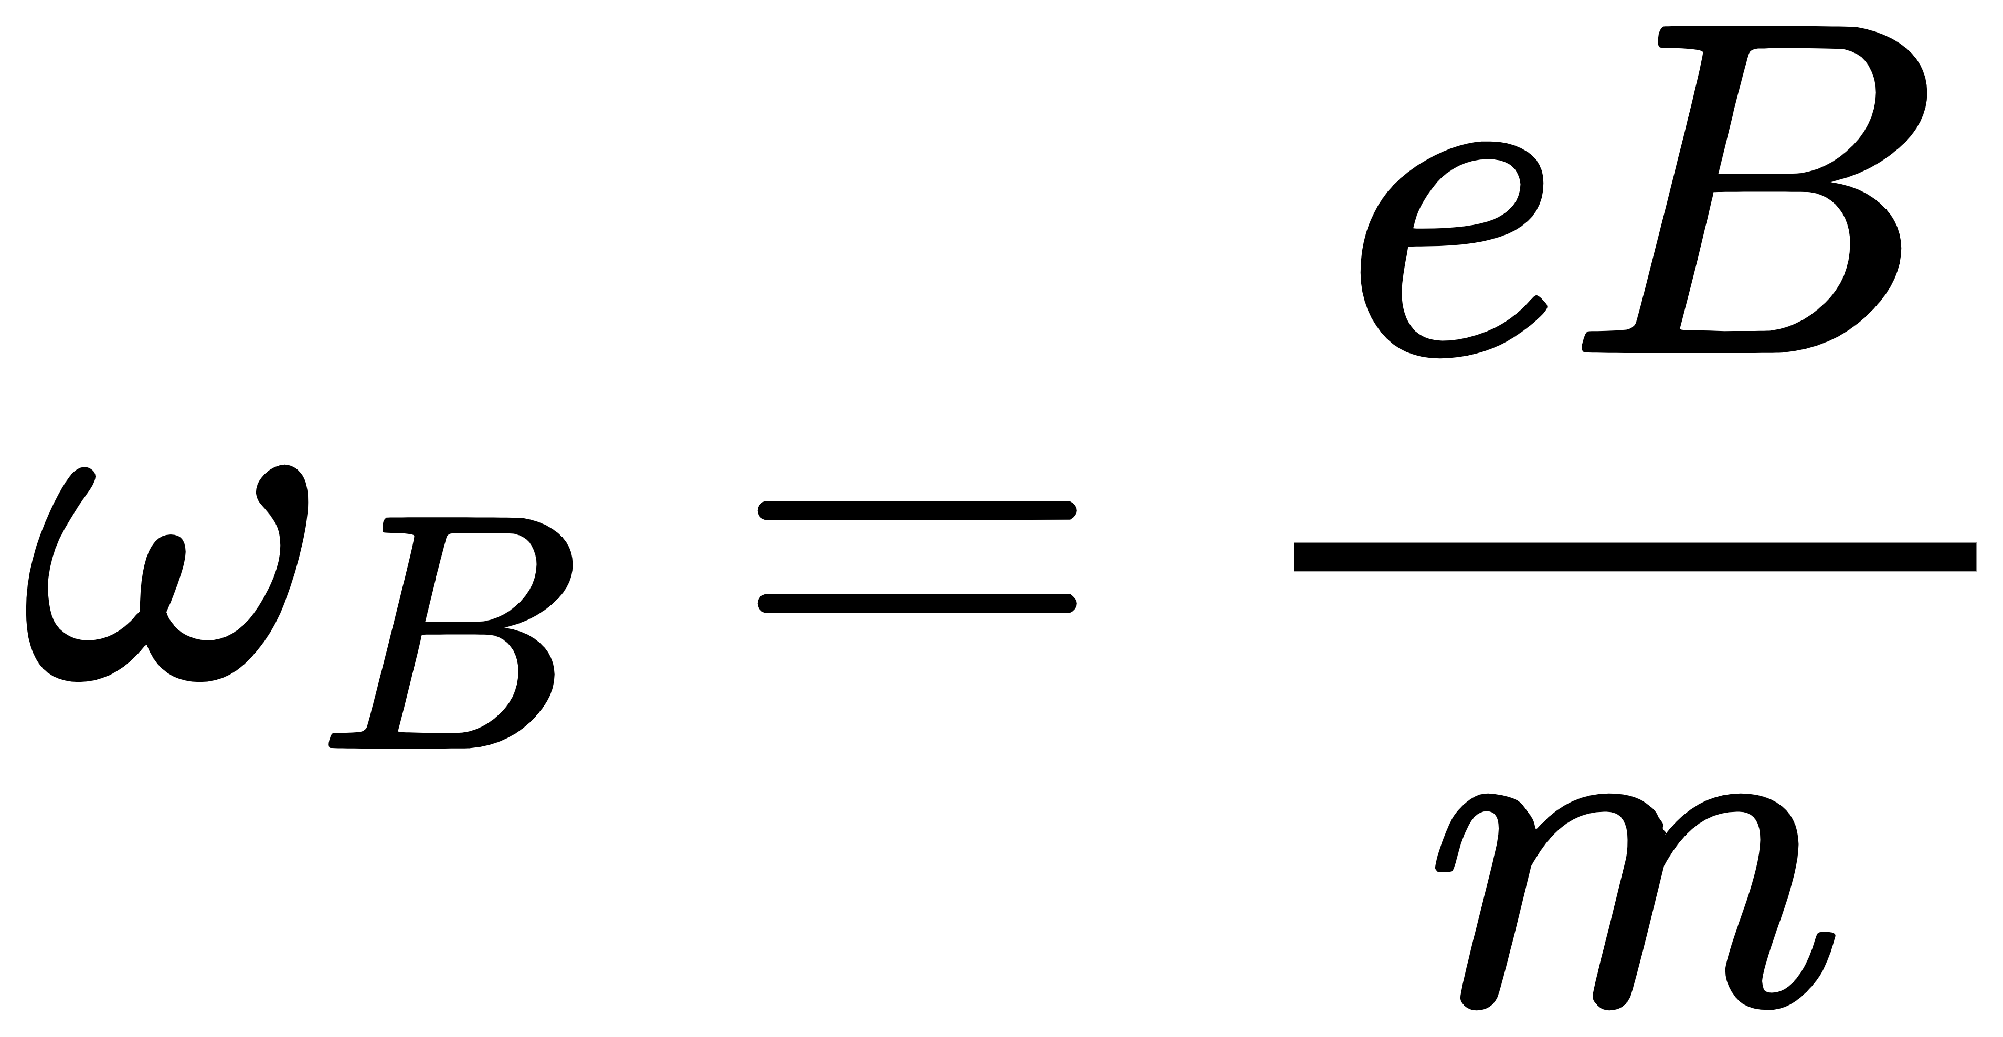
Classical Hall Effect and Drude Model
where

Slide 4
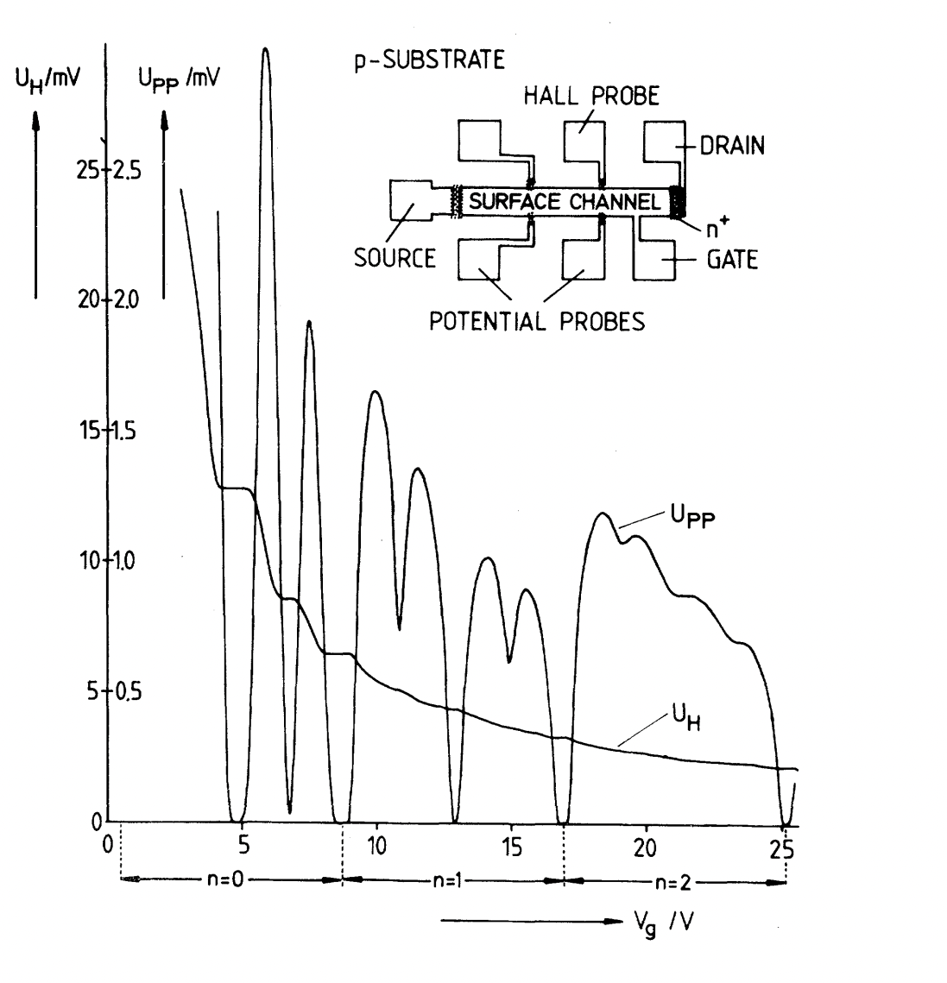
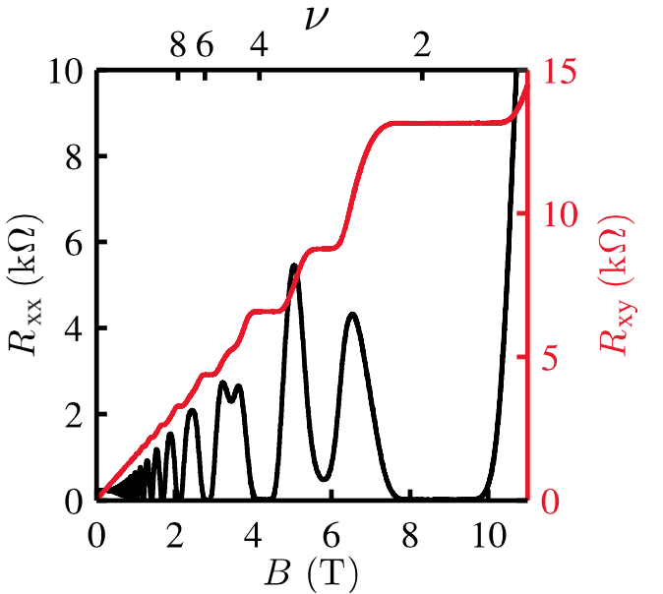
Integer Quantum Hall Effect
[1]Klitzing K, Dorda G, Pepper M. New method for high-accuracy determination of the fine-structure constant based on quantized Hall resistance[J]. Physical review letters, 1980, 45(6): 494.
[2]https://topocondmat.org

Slide 5
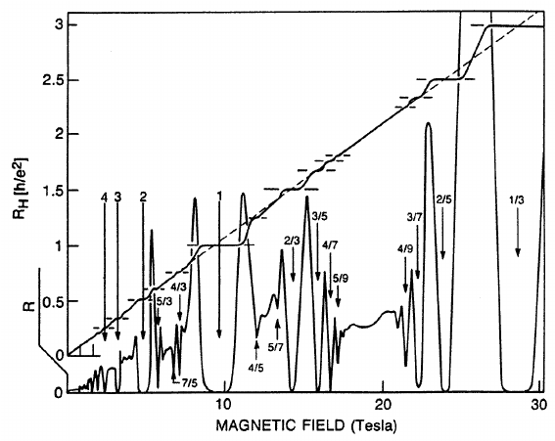
Fractional Quantum Hall Effect
[1]Introduction to the Fractional Quantum Hall Effect.Steven Girvin

Slide 6

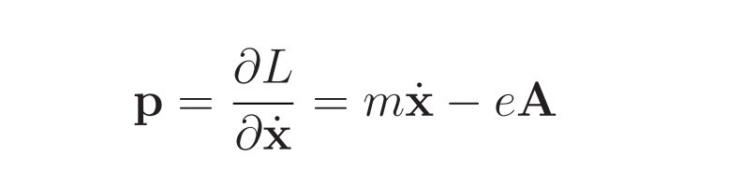


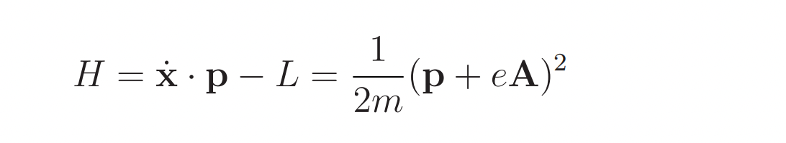
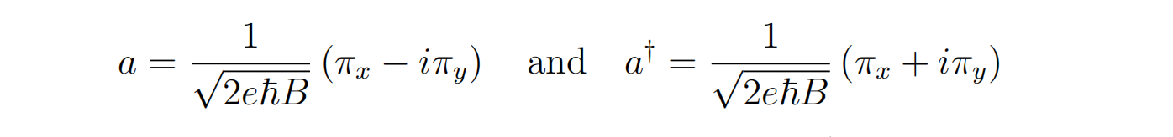
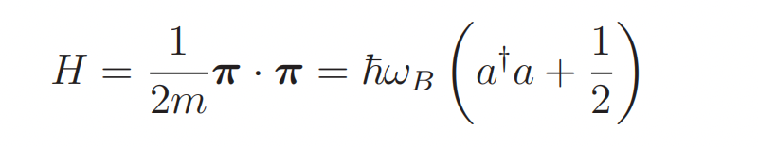
Landau Levels
前面要写基本假设吧！！！无相互作用啊！
Notes:
其他可以黑板上说，或者直接说！

Slide 7
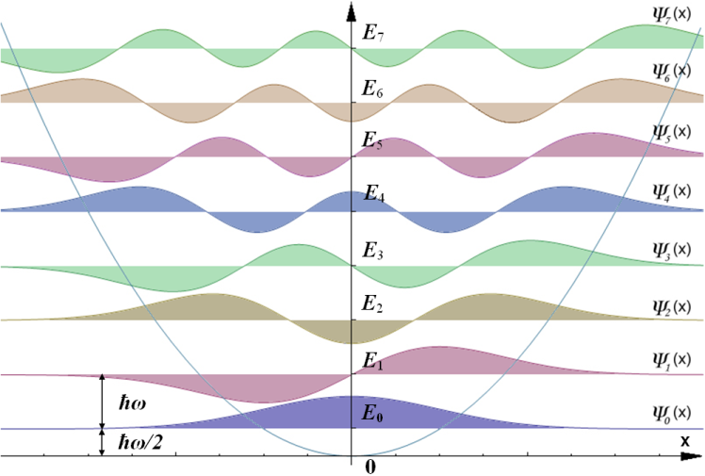
Landau Levels
放一幅2d谐振子，形象化！！
Notes:
其他可以黑板上说，或者直接说！

Slide 8
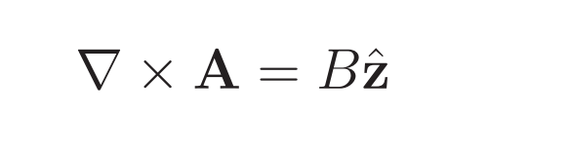

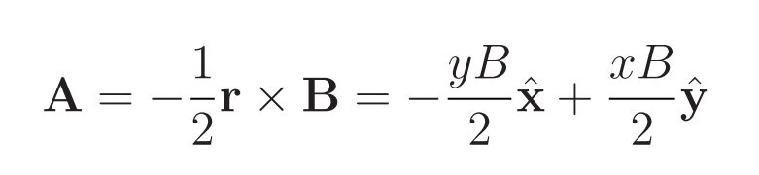
Landau Levels
gauge:
1.Landau Gauge
2.Symmetry Gauge
分析对称性
Notes:
其他可以黑板上说，或者直接说！

Slide 9
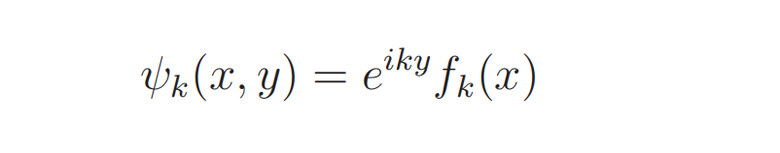
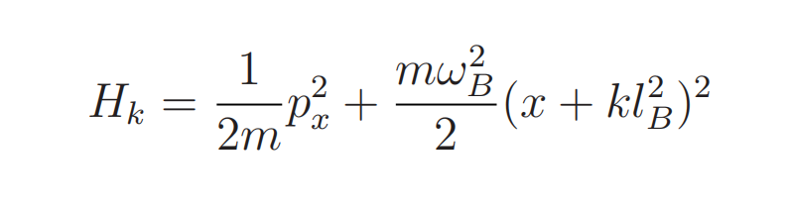
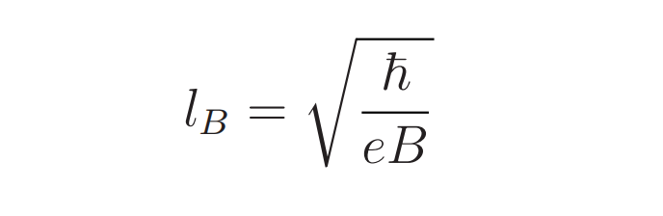
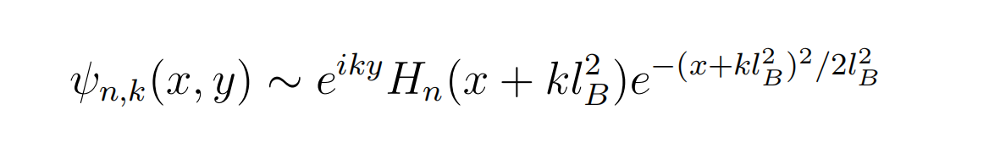
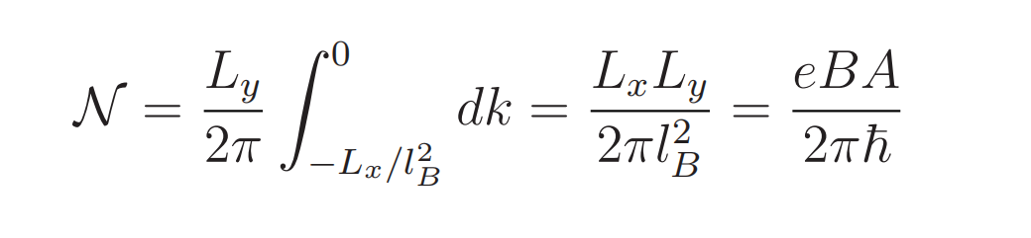
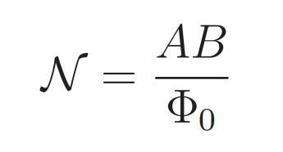
Landau Levels
Notes:
其他可以黑板上说，或者直接说！

